Slide 1
Behaviour is Language
The Language of School Exclusion
10th July 2020
Sarah Martin-Denham
University of Sunderland

Slide 2
Sarah:@blogsenco
Senior Lecturer and Researcher
Programme Leader and Tutor NASENCO
Author of SENCO Handbook and Teaching Children with SEND​
Convenor Interdisciplinary Research Network: Adverse Childhood Experiences North East​
Chair: Independent SENCO Network​
Senior Fellow Higher Education Academy​
Vice-Chancellor Teaching Fellow

Slide 3
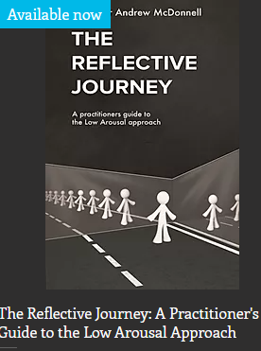
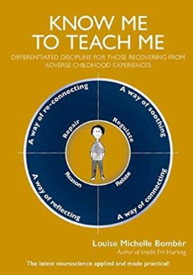
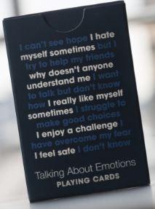
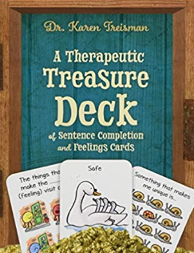
The loan packs
We are hoping for 20-25, they will be across the region…

Slide 4
Exclusion Research in Sunderland
In total there were 174 participants interviewed. In addition, there were three advisory groups, 12 children, five professionals from health/support services and five education professionals.
This is the most substantial piece of primary research carried out to date on the enablers and barriers to mainstream schooling for those at risk of school exclusion in England.

Slide 5
Focus of today...
‘Enablers and Barriers to Mainstream Schooling: Learning from research on school exclusions with caregivers, children and professionals’
(sure.sunderland.ac.uk – Search by Author Martin-Denham: publication 8)

Slide 6
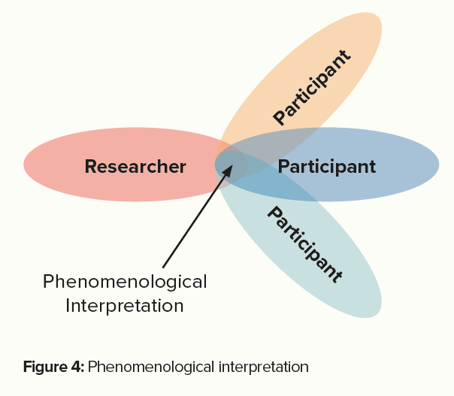
Methodology
The aim of the research was to provide a detailed examination of personal lived experiences of participants, the qualitative approach chosen was interpretative phenomenological analysis (IPA) (Smith and Osborn, 2015).

Slide 7
Interview excerpts (voiced by actors)
Interview 1: Year 10
Link
Interview 2: Year 10
Link
Interview 3: Year 6
Link
Interview 4: Year 5
Link

Slide 8
What children reported finding difficult in mainstream school
KS1
‘I find it difficult to do maths - ‘cause I don’t really like maths’
‘I find it difficult because the work is too hard’.
‘I need help in the playground because me and a child had a problem’ and ‘playground the most’.
KS2/3
‘There were too many people and I needed so much help, I wasn’t getting any at all, I didn’t cope well’
‘The fire alarms there are so high pitched. That’s why I’m glad I’ve left… It’s a lot, a lot of noises’
‘It is hard for the teachers to get round’
‘Every time the times tables get quick… I used to get one out of ten and others get ten out of ten, but they were too big and there was a timer, you had to read how many you got in front of the class’
KS4
‘They didn’t support me, so I was going home crying… because they weren’t helping me through anything, they just told me to get on with it’
‘The fact is when I asked for help they wouldn’t give it to me, they would just say I will come back to you’.
‘We would be outside for twenty minutes to make sure we had our coats and correct uniform… I was always pulled out of the line and had to wait for the headteacher because I was talking apparently’

Slide 9
Secondary headteachers Use of isolation ‘If children are not behaving to the standards we expect’ (p. 60)
"We have isolation, if that doesn’t work we are supposed to send them home, but my assistant head in charge of that area is a bit soft and will say ‘I don’t want to send him home, or he’s a looked after child’ so we sit him in the corridor outside"
"We use isolation as an evidence-gathering tool, especially for young people with EHCPs. We know that our isolation room it does have booths and we know that all the latest stuff is not to put our LAC children in there, I mean we don’t do that, but we’ve got to prove some way where they’re not coping"
"We do set toilet time and we still feed people. The parents are informed and there is no parental consent sought"
*The premise of the Code is that professionals need to understand the reasons for children’s behaviour (DfE, 2015a).

Slide 10
Primary headteachers Use of isolation
'The first one was absolutely horrendous aggression between themselves and staff and the second one was that that child has been building up a pattern... I have never had a child scream and shout at staff in the way that he did. He had escalated until he pushed a member of staff'
'There are times when a child has had to be removed out of the classroom because sometimes frustration can manifest itself in throwing chairs or whatever and at that point the safety supersedes everything'
The majority of primary schools used other approaches to isolation:
'Being ‘sent’ to work in the headteacher’s office, given jobs to do, toilet breaks, speaking to the school counsellor, going into another classroom and nurture/sensory rooms' (p. 61).

Slide 11
Nursery headteachers Use of safe spaces
Nursery headteachers said they took children to safe spaces, once the child was calm the staff. In nursery schools staff also provide comfort through physical contact
'Huge temper tantrums… scratching members of staff, biting, kicking, all sorts of things, for that child, it was appropriate to remove him'
'When a staff member could read that he was ready enough to come back then they would say ‘would you like a cuddle?’
‘We will come into my room and we’ll sit together and rock until she’s calmed down... At first, I did have to explain to the staff that this isn’t about us rewarding her behaviour; it’s about us supporting her to learn to regulate it. We’ve got that now'

Slide 12
Alternative provision Use of isolation ‘It’s a sticking plaster over a haemorrhage’
Similar to primary and nursery headteachers views the alternative provision and additional resourced provisions used isolation when children in their words, were ‘having a meltdown’ and ‘hitting and kicking and screaming’. The reasons isolation was used was to prevent children from witnessing violent behaviours and to allow others to continue with learning.
‘you would hope that curriculum support is a pro-active measure; the isolation rooms are a reactive measure… time out cards trusted adults. All of those strategies are prevention, not the cure. But If that doesn’t work, then it is the isolation’.
Alternative approaches ‘maybe walk up and down the corridor to try and regulate them’ and ‘space just beyond the classroom where members of staff will go and sit with them’.
There was an acknowledgement from all professionals interviewed that isolation was ineffective at modifying behaviour.
(p. 62-63)

Slide 13
Health and support professionals: Views on isolation
It was clear from the interviews with health professionals and support services that they were unable to understand how and why isolation booths were used in some schools.
They commented on the impact on the child’s learning ‘they can bring work if they want, they don’t have to because they have lost the right to be taught’.
This view was echoed by those of the children who also stated they were not taught when in isolation booths.
One participant raised the point that ‘you only need to look at the policies, it is all written down, I don’t know how they dare. I sit in schools and I look and they have prominent signs about how much education you miss if you have one day off school. But I think ‘you have just made that child sit in an isolation booth for an hour or for a whole day’. How does that work?’ Some described concern over the impact on the child’s mental health on not being able to socialise at break and lunchtimes and of not being spoken to when in isolation.
‘You could say that the isolation booths are false imprisonment. Even detention. I know the children could walk out but there would be consequences for that’.

Slide 15
10-minute wander and ponder...
Do you agree some schools are trying to 'stick a plaster over a haemorrhage?'
What are the barriers to change in schools systems and processes?
We will start to unpick once you have grabbed a drink

Slide 16
Solutions: From the children and young people advisory group (p. 70)
Systems and processes
‘Teachers need to pick their priorities, I got isolated for not tucking my shirt in’
‘Take away isolation booths’
‘Try to understand the problem rather than dish out punishment’
‘You should be able to express yourself and not be punished for things that have nothing to do with learning’
More support
‘Be fair and give more support in lessons’
‘To have teachers that actually understand learning difficulties’
‘Have more ways for children to cope (self-regulation)’
'You can't cope in big classes, there are too many people and you cannot get help'
Respect
‘Teachers need to respect us if they expect it back'
‘Teachers to have a better attitude towards children’
‘Schools need respect for children’
More on p. 70

Slide 17
Solutions: From the children and young people (p. 75-76)
KS1:
‘Shorter school days’ and
‘I could have been helped by going to nurture group’
‘Cuddling makes me happy’
‘Having time to talk room’
‘Help me make good choices’
‘To bring in teddies and fidget cubes’
KS2/3
‘If someone had sat and explained the work. I would have done it. I would have understood it’
‘If they had given you a list, like a PowerPoint. It tells you, you need to do this, then this and this’
‘I need more staff helping, explaining things, maths was the only lesson I could get because I have dyslexia, they weren’t helping with that’
‘Maybe not restrain me as much’
‘The more they shout, the more I shout’
‘Teachers not shouting when they think they are big, stop screaming at us’
‘Football calms me down when I am with my friends’.

Slide 18
Caregivers KS4 (p.72) Victimisation
Within the caregiver’s responses, some perceived that their child was not accepted by other children or that other children were able to identify differences which led to their child being targeted
‘The children then knew he was different, they had a target of someone to bully, someone to wind up. They thought it was funny when he went bang’
‘He told me that the three boys had been mouthy earlier on in the day. They called him ‘a scummy care kid’ he said ‘I’m not going to be called those names. You know what it is like for me’ They said to him ‘your mum didn’t want you’.

Slide 19
Caregivers KS4 Lack of reasonable adjustment
‘CAMHS gave him a fiddle toy. But then teachers took them off him and said they were ridiculous and put them in the bin'
‘His social worker, who had been his original social worker from coming into care left. His pastoral worker at school left, they were massive losses for him’
‘The expectations of, not behaviour, but of conforming readily, all of the time. Sit. Speak. Work’
'You cannot even speak in class and they put you in inclusion. I think a lot of mainstream schools just focus on getting the grades. Rather than having a little bit of fun within school time. Not just having to sit there, sad, in total silence’

Slide 20
Caregivers what could have prevented the school exclusion (KS1-3) p. 78
'They needed to listen. They were very quick to just say he was naughty’
‘Listen to the kids when they get a bit silly in their chairs, they can’t sit still. Now’s the time to take them out, to make them run around the field a couple of times’
‘They need training. They need to understand not just the strategies but how to apply them and go and do a course to understand sometimes their reaction is anxiety’
‘Doctors pushed me back to nursery staff who pushed back at me, I had nowhere to turn’
‘I was told to wait until he was five, he was only three, as soon as he was five he was permanently excluded’

Slide 21
Discussion...
There is a sense that the caregivers felt that the only route to getting support from schools is through gaining a diagnosis from a health professional, without these plans, adjustments and flexibility in terms of behaviour sanctions would not happen in their child’s school.
‘The medical report said he needs good support mechanisms or he will experience significant behavioural difficulties and he did’ (no formalised plans)
‘We were never given a copy of his plan until they excluded him’ (SEN support plan)
‘Stick by the plans; they haven’t got the staff or resources to do it, a lot of it is about resources I think’ (EHCP)
(p. 78)

Slide 22
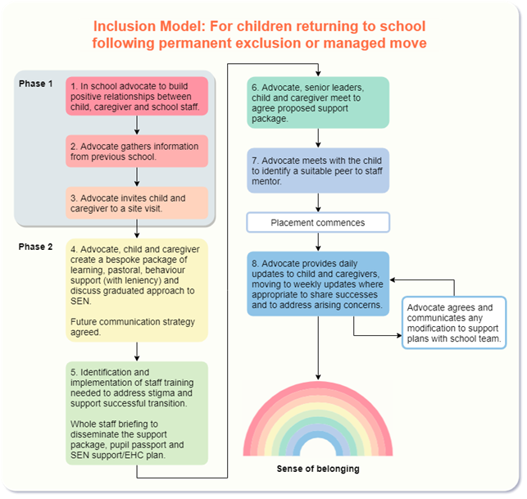
Adapted from Martin-Denham, 2020a

Slide 23
Guidance...
This may be helpful
COVID-19 recovery: Engaging and re-engaging children and young people on Permanent School Exclusions or Managed Moves at all stages of transition
Martin-Denham, Taylor and Walker, 2020

Slide 24
References
Martin-Denham, S. (2020) An investigation into the perceived enablers and barriers to mainstream schooling: The voices of children excluded from school, their caregivers and professionals. Sunderland: University of Sunderland. https://sure.sunderland.ac.uk/id/eprint/11941/
Martin-Denham, S. and Donaghue, J. (2020) A review of fixed-period and permanent exclusions in children with SEN designation in the City of Sunderland. London: University of Sunderland. http://sure.sunderland.ac.uk/id/eprint/11940
Martin-Denham, S., Taylor, C., and Walker, D. (2020) COVID-19 recovery: Engaging and re-engaging children and young people on permanent school exclusions or managed moves at all stages of transition: Research and practice-informed guidance for alternative provision providers.

